Slide 1


TEAM MEDHAVI (MED- 35)
Problem statement: Patient Engagement (PSID- 10)
Develop an interactive patient engagement platform that educates patients about their conditions, treatments, and preventive measures. The platform should use gamification, personalized content, and social support networks to motivate patients to stay engaged with their health.
This presentation introduces our advanced chatbot and machine learning model designed to enhance patient healthcare through :
Personalized services and insights
Data analysis
AI-powered recommendations
Communication tools
BY-
Priyanshu Jha (12219605)
Rohit Kumar (12320013)
Dhruv Agarwal (12316502)

Slide 2

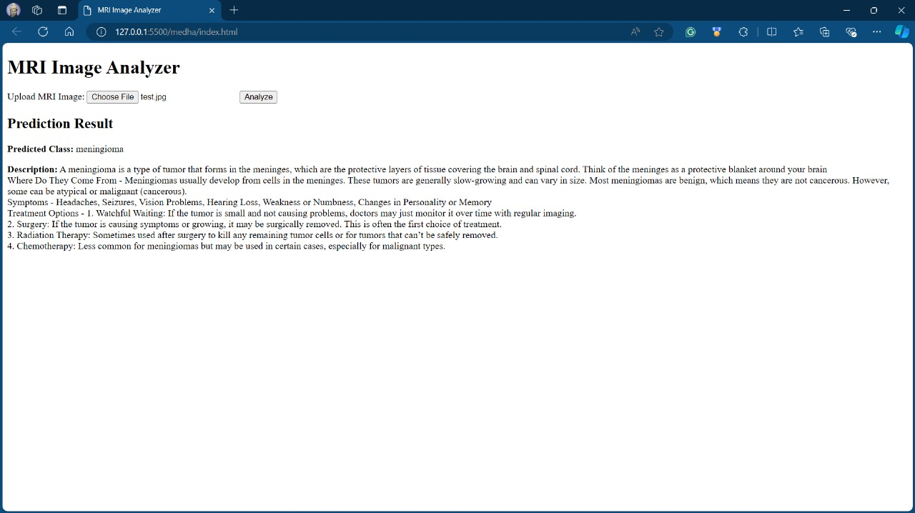
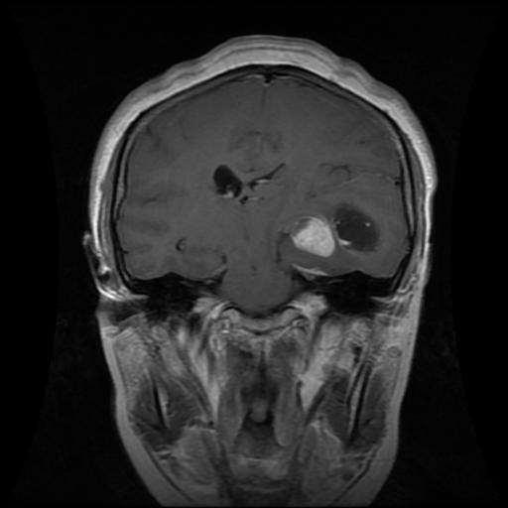

Patient Data Analysis and Report Generation
Collecting Data
Data Analysis
The chatbot collects patient data from wearable devices, electronic health records, and patient interactions. This data provides a comprehensive picture of the patient's health status.
The model uses advanced machine learning algorithms to analyze the collected data, identifying patterns and trends that reveal insights into a patient's health conditions, potential risks, and medication effectiveness.
Generating Reports
Based on the analysis, the model generates concise and informative reports that are easily accessible to patients and their healthcare providers, facilitating informed decision-making and personalized care plans.
FIG: TEST IMAGE

Slide 3

Personal Health Education Kit
Personalized Content
Medical Imaging
The chatbot provides patients with customized health education based on their individual needs, risk factors, and medical history. This ensures that the information is relevant and tailored to their specific situation.
The chatbot incorporates ML to analyse the radiology reports and predict the results. Patients can actively participate in their health education, improving comprehension and retention.
Resource Library
Ongoing Support
The chatbot provides access to a library of curated health resources, including articles, videos, and reputable websites. Patients can explore diverse sources of information to expand their knowledge about their conditions.
The chatbot is available 24/7 to answer questions, clarify doubts, and provide ongoing support. Patients can engage with the chatbot whenever they need additional information or guidance.

Slide 4
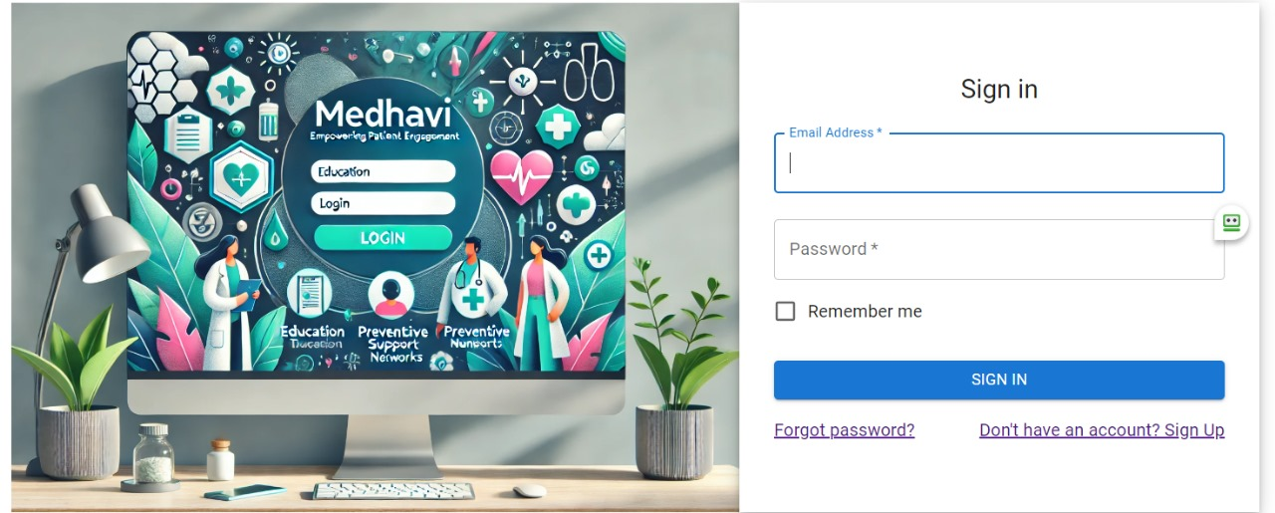
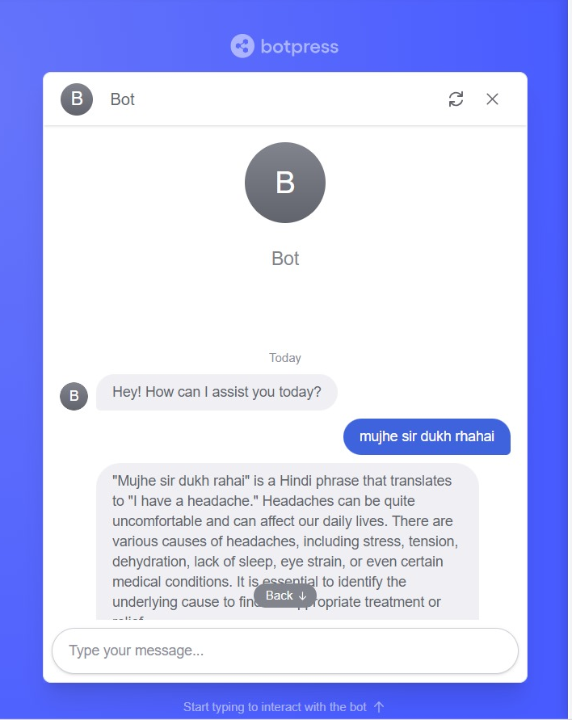
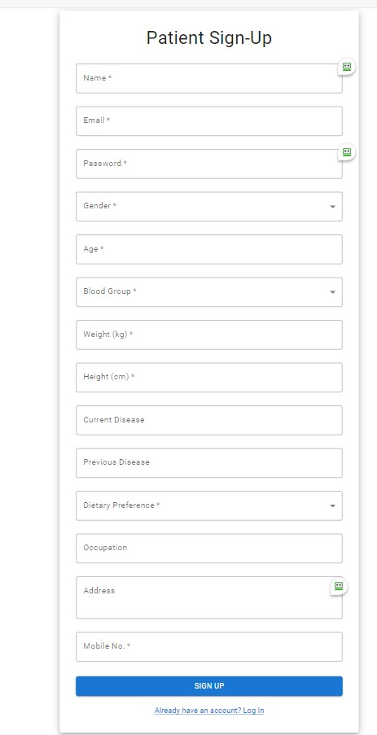
Personalized Health Recovery Plan
Voice module interaction
The chat-box interacts with the user by taking inputs in the form of audio notes and providing results in the same format to provide accessibility to a larger population.
Visual Solutions
The model provides strategies and interventions based on the patient's condition, preferences, and lifestyle in image format for better understanding. These strategies include exercise plans, nutritional guidance, and do’s/don’ts.
Multilingual
The existing AI interfaces allow interactions in more than 9 Indian languages making the model more user friendly and promoting inclusivity.
Continuous Support
The chatbot offers ongoing support and encouragement throughout the recovery journey, answering questions, addressing concerns, and promoting motivation. Patients feel empowered and supported in their efforts.

Slide 5

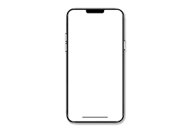
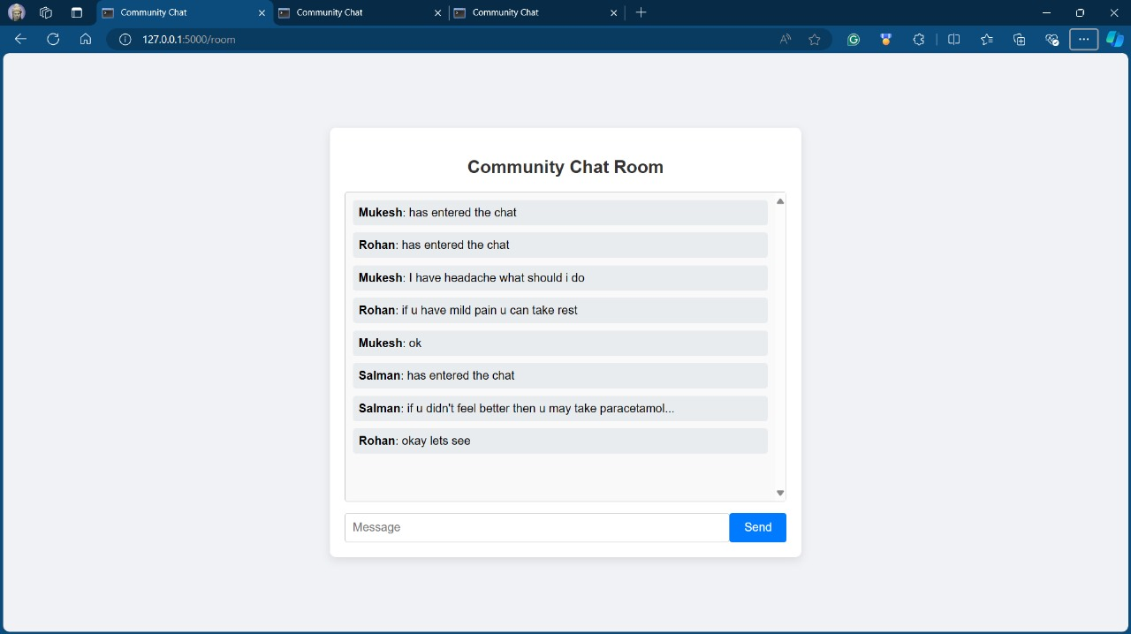
Social Connectivity Messenger
Connecting with Others
The chatbot enables patients to connect with others who share similar health experiences through a secure and private messaging platform. This fosters a sense of community and provides emotional support.
Sharing Information
Patients can share relevant information about their health journey, progress updates, and experiences with others in the community. This facilitates peer-to-peer learning and support.
Building Connections
The chatbot promotes social interaction and encourages patients to connect with their support networks. This can alleviate feelings of isolation and foster a sense of belonging.

Slide 6

Market Potential
Overview of the Patient Engagement Market
The global patient engagement market is rapidly growing, driven by advancements in technology, increasing demand for personalized healthcare, and a greater emphasis on patient-centric models.
Market Size and Growth Rate
Current Market Size: The global patient engagement market was valued at approximately $15 billion in 2022.
Projected Growth Rate: It is expected to grow at a compound annual growth rate (CAGR) of around 20%, potentially reaching $45 billion by 2027.
Target Audience
Healthcare Providers: Hospitals, clinics, and telehealth services seeking to enhance patient engagement.
Patients: Individuals with chronic conditions, those in remote areas, or anyone seeking convenient healthcare solutions.
Payers: Insurance companies looking to improve patient outcomes and reduce costs through better engagement strategies.

Slide 7
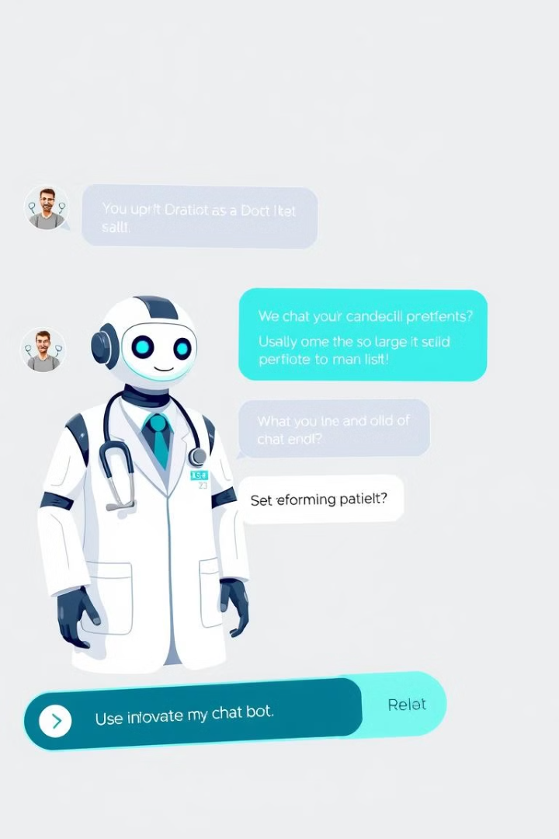



Segment Analysis
Social Group Connection
Interactive Chatbot
Market Size: Estimated at $1.5 billion in 2022.
- Growth Drivers:
- Increased use of social media and online platforms for health discussions.
- Potential Impact: Facilitating peer support can lead to better adherence to treatment plans and improved mental well-being.
Market Size: Estimated at $2 billion in 2022.
- Growth Drivers:
- Growing demand for 24/7 patient support and efficient communication channels.
- Potential Impact: Enhances patient engagement through immediate access to information, leading to higher satisfaction rates.
Virtual Doctor Calling Module
Machine Learning and Report Analysis
Market Size: Estimated at $8 billion in 2022.
- Growth Drivers:
- Accelerated adoption of telehealth solutions post-COVID-19.
- Potential Impact: Expands access to care, especially for underserved populations, leading to better health outcomes.
Market Size: Estimated at $3 billion in 2022.
- Growth Drivers:
- Demand for personalized medicine and predictive analytics.
- Potential Impact: By improving health literacy and enabling proactive care, this segment can significantly enhance patient outcomes.

Slide 8

Benefits and Impact
Machine Learning and AI-Based Report Analysis
Benefits:
- Personalized Insights
- Predictive Analytics
- Automated Interpretation
Impact:
- Improved Health Literacy
- Enhanced Self-Management.
- Timely Interventions.
Social Group Connection
Benefits:
- Community Support.
- Resource Sharing.
- Motivation and Accountability.
Impact:
- Reduced Isolation.
- Enhanced Engagement.
- Improved Outcomes.
Interactive Chatbot
Benefits:
- 24/7 Availability.
- Efficient Communication.
- Personalized Interaction.
Impact:
- Increased Accessibility.
- Streamlined Processes.
- Higher Satisfaction Rates.
Virtual Doctor Calling Module
Benefits:
- Convenience.
- Integrated Care.
- Accessibility for All.
Impact:
- Increased Access to Care.
- Continuity of Care.
- Positive Health Outcomes.

Slide 9

Product Overview
Features
- Report Analysis.
- Social Group Connection.
- Interactive Chatbot.
- Virtual Doctor Calling Module.
Value Proposition
- Empower patients with actionable insights and community support.
- Enhance communication between patients and providers.
- Streamline healthcare processes, improving efficiency and satisfaction.
Marketing Strategy
1. Positioning
Position the platform as a comprehensive solution for patient engagement that leverages cutting-edge AI technology to improve health outcomes.
2. Branding
Develop a strong brand identity that resonates with trust, innovation, and patient empowerment.
3. Pricing Strategy
- Subscription Model: Monthly or annual fees for patients.
- Tiered Pricing: Basic access vs. premium features (e.g., personalized consultations).
- Discounts for healthcare providers who integrate the platform into their services.
Business Plan

Slide 10

Sales Strategy
1 Direct Sales
Target healthcare providers directly through sales teams to encourage adoption within clinics and hospitals.
2 Online Sales
Develop an easy-to-navigate website where patients can sign up directly for the service.
3 Referral Programs
Implement referral incentives for both patients and healthcare providers to encourage word-of-mouth marketing.
Metrics for Success
Key Performance Indicators (KPIs)
- User Adoption Rate: Percentage of target audience using the platform.
- Engagement Metrics: Frequency of chatbot interactions, social group participation.
- Patient Satisfaction: Surveys to measure user satisfaction and perceived value.
- Health Outcomes: Track improvements in patient health metrics over time.
Business Plan

Slide 11


FUTURE SCOPE
Medication Reminders and Notifications
Tracking Adherence
Medication Schedule
The model tracks medication adherence and provides feedback to patients and healthcare providers. This helps identify potential issues and intervene early to prevent adverse outcomes.
The chatbot helps patients manage their medications by creating a personalized schedule based on their prescriptions, dosage, and frequency.
Reminders & Notifications
The chatbot sends timely reminders and notifications to patients through their preferred communication channels, ensuring that they take their medications on time and avoid missed doses.

